Slide 1

Walmart Sales Analysis
Presentation by Michael Leggett
https://github.com/mleggett25/Walmart-Sales-Analysis

Slide 2
Overview of Analysis
The purpose of this analysis is to gain insights into sales performance, identify areas for improvement, and make data-driven decisions to increase revenue.
I will seek to answer the following questions:
What was the total revenue generated by Walmart during the period covered by the dataset?
Which stores performed best, and which stores need improvement?
Which variables have an effect on sales?
How much do holidays influence sales?

Slide 3
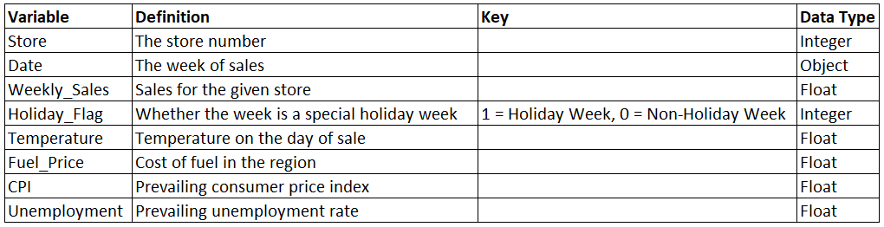
Dataset
The dataset provided contains sales data for 45 Walmart stores.
The dataset includes 8 variables and 6435 samples.
The data provides a ‘Holiday_Flag’ variable which is a Boolean field that shows whether the week is a special holiday or not. This signifies promotional markdown events throughout the year preceding prominent holidays which include the Super Bowl, Labor Day, Thanksgiving, and Christmas.

Slide 4
Data Cleaning
To prepare the data for importation and analysis in a SQL database, I inspected the data using Python and cleaned the data as necessary.
The data was cleaned by:
Checking the datatypes for each variable;
Checking the data for missing values;
Replacing values for more readable and easier to understand data;
Checking for duplicate rows.

Slide 5
Data Exploration
To explore the data, I used a PostgreSQL database.
The dataset ranges from February 5, 2010 to October 26, 2012.
Over the span of the three years, Walmart had a total revenue of $6,737,218,987.11
The minimum weekly revenue was $209,986.25
The maximum weekly revenue was $3,818,686.45
The average weekly revenue was $1,046,964.88

Slide 6
Segmentation and Binning
To identify which stores are higher or lower performers than others, I created a new column that would segment the data into four bins by identifying each store as either:
High Performance
Mid-High Performance
Mid-Low Performance
Low Performance
This was accomplished by finding the average total revenue of all the stores, which was $149,715,977.49
I then looked at the stores with total revenues above the average and below the average and found their respective medians. This divided the above average stores into two groups, and the below average stores into two groups, which created the four bins.

Slide 7
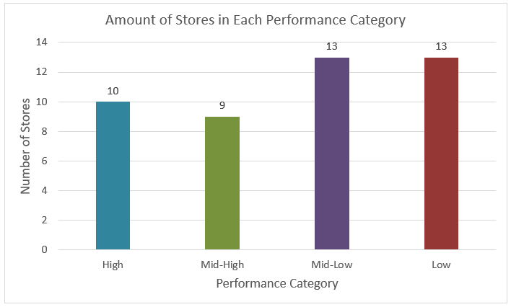
Performance Categories

Slide 8
Findings and Analysis

Slide 9
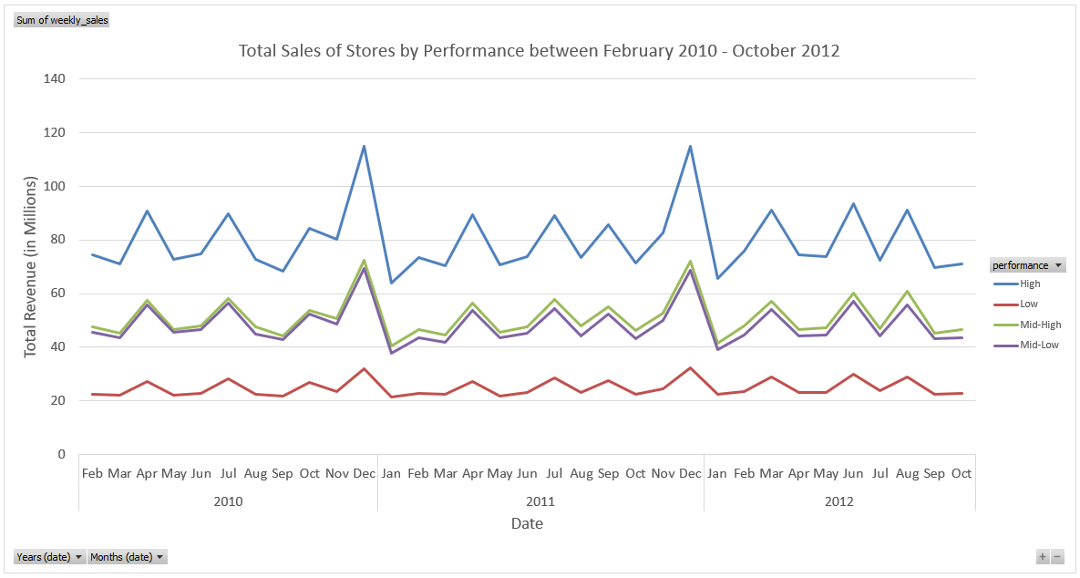
Sales by Month Each level of performance follows a similar pattern of revenue. Strong peaks of revenue between November and December for Black Friday and Christmas. Large dip in revenue in January after large holiday spending. Low performance stores have noticeably smaller peaks around the holidays.

Slide 10
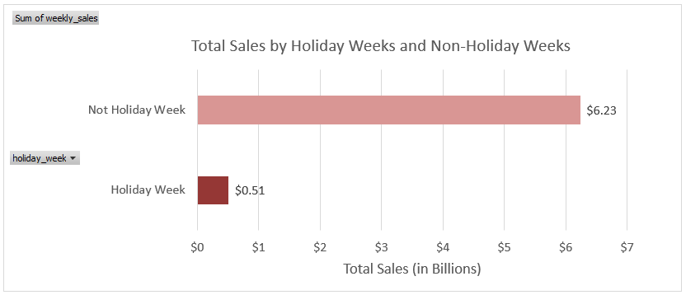
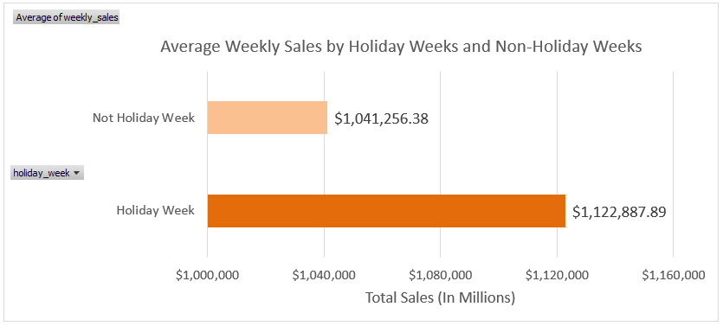
Comparing Holiday and Non-Holiday Sales Holiday sales accounted for approximately 8% of total revenue over the three years. Revenue increases at a rate of about 7.5% during the holidays.

Slide 11
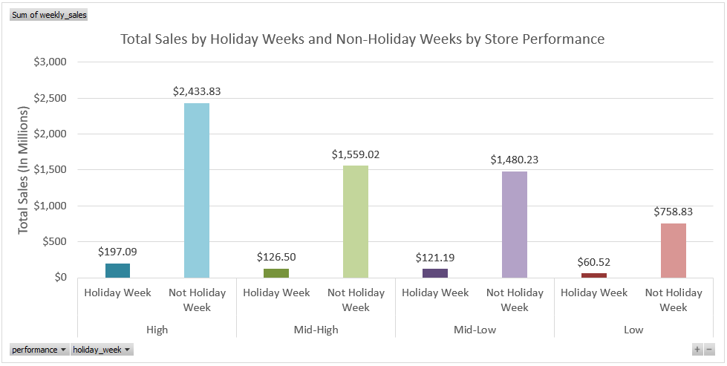
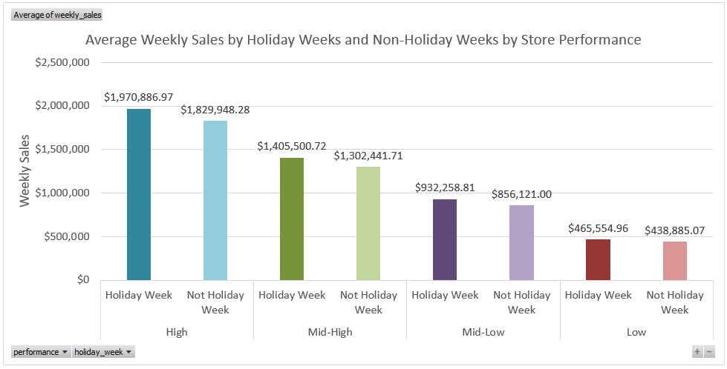
Comparing Holiday and Non-Holiday Sales Each level of performance shows a similar pattern of Holiday and Non-Holiday sales. Percent Difference between Average Holiday Weeks and Non-Holiday Weeks High: 7.4% Mid-High: 7.6% Mid-Low: 8.5% Low: 5.8%

Slide 12
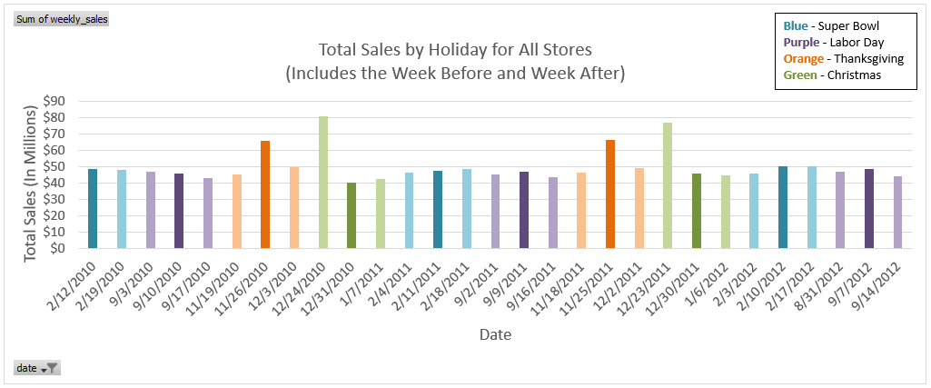
Sales Around the Holidays No significant change between week before and week after sales for the Super Bowl and Labor Day. Sales are much higher the week of Thanksgiving due to Black Friday. Sales are much higher the week before Christmas as most people will be shopping for presents for the holiday.

Slide 13
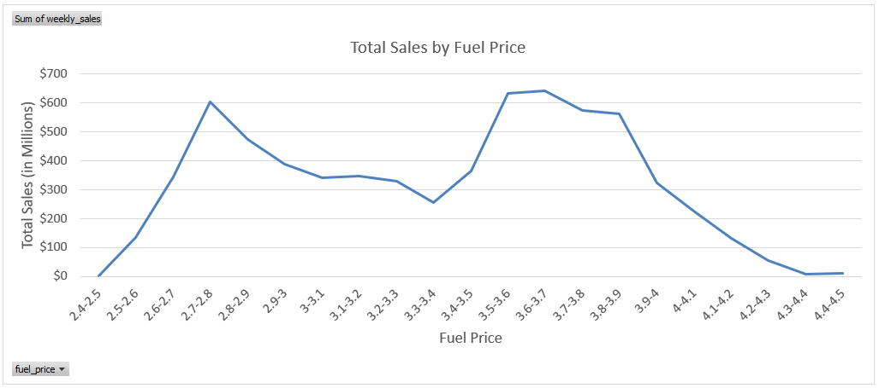
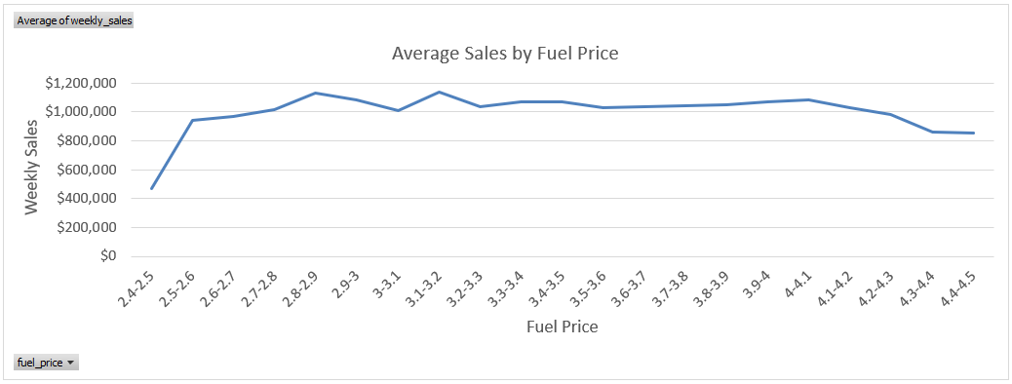
Fuel Price Fuel price does not have a significant effect on weekly sales. The drop in sales at fuel prices between $2.40 and $2.50 can be explained by the rarity of those fuel prices. Of the 6435 observations, there was only one record between $2.40 and $2.50.

Slide 14
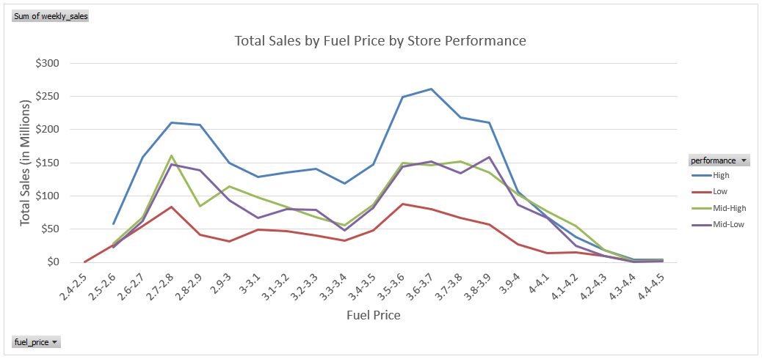
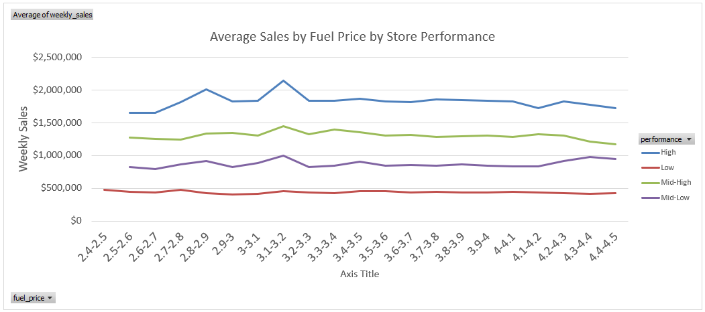
Fuel Price Sale trends are similar amongst the different performance levels and when compared to the graph with all stores. These graphs further show that fuel prices do not significantly affect weekly sales.

Slide 15
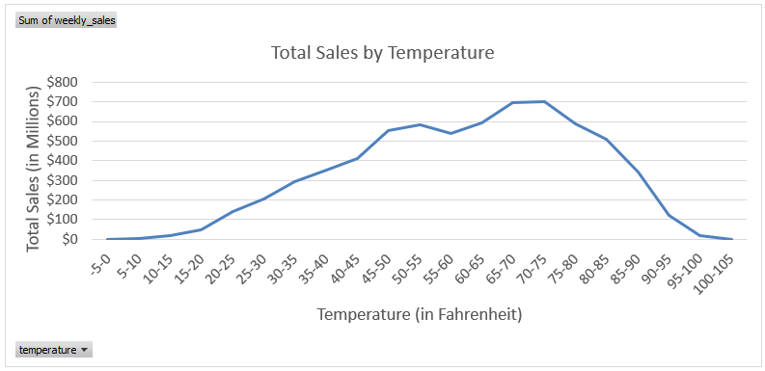
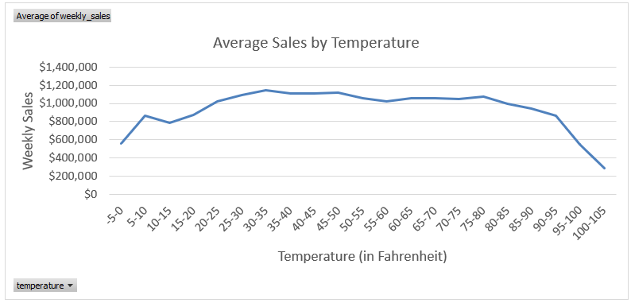
Temperature Temperature does not have a significant effect on weekly sales.

Slide 16
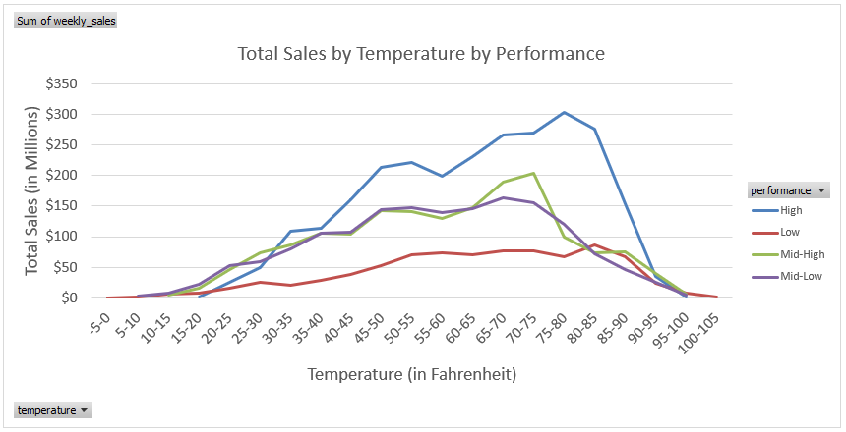
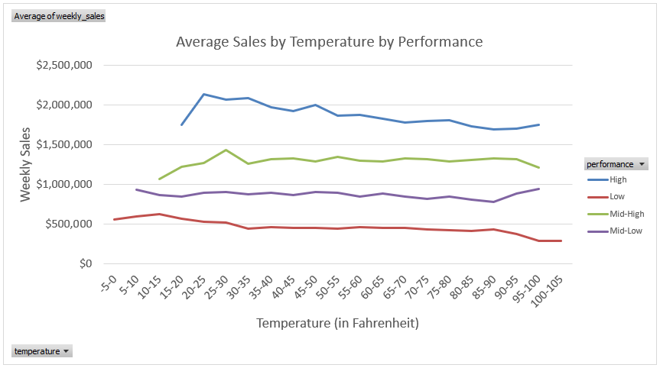
Temperature Sale trends are similar amongst the different performance levels and when compared to the graph with all stores. These graphs further show that temperature does not significantly affect weekly sales.

Slide 17
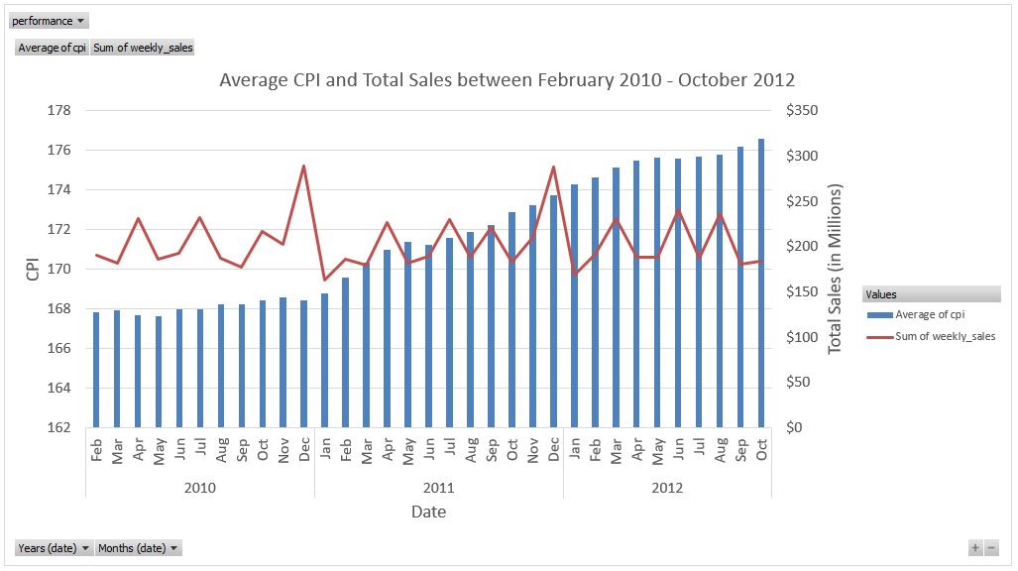
Consumer Price Index (CPI) Steady increase in the average CPI during the three-year period, starting at about 168 in February 2010 and reaching about 176 in Oct 2012 – an almost 5% increase. Total sales maintain a steady pattern. With revenue stagnant and prices higher, this would indicate that less products are being sold.

Slide 18
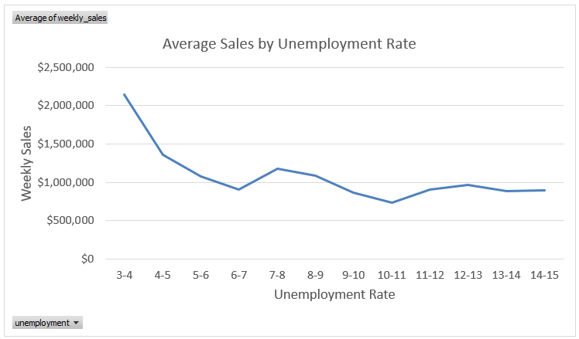
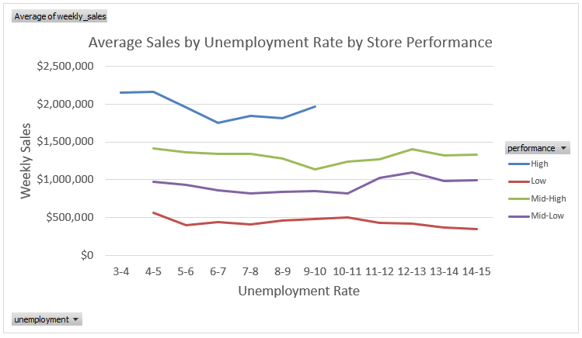
Unemployment The unemployment rate has little affect on sales. Spike increase in the first graph at 3-4% is caused by the high performing stores being the only group with that unemployment rate. High performing stores do not have unemployment rates greater than 10%. This might indicate that the high performing stores are in more affluent areas.

Slide 19
Conclusions

Slide 20
Recommendations
Low performing stores should focus on trying to increase sales during the holidays.
Low performing stores should take strategies from Mid-Low performing stores as these stores performed similarly and had the highest holiday percentage difference.
If low performing stores were able to close the percentage gap, holiday weeks would generate an extra $38,163 on average.
Walmart should monitor the Consumer Price Index as it might be the cause of stagnating revenue. Walmart might want to consider increasing prices, cutting costs, or changing marketing tactics.
Walmart should not take temperature or fuel price into serious account when determining prices.
Walmart should consider loyalty programs to change consumer buying habits to increase sales, specifically for the lower performing stores.

Slide 21
Future Analysis
Location data for the stores and census data for their surrounding areas might help provide more insight into the disparity of the different performing stores.
Since the dataset ends in October 2012, it could be helpful to use a machine learning algorithm to help predict future weekly sales going into 2013. This could also help potentially see the effects of the Consumer Price Index if it were to continue to increase.
While temperature did not have a significant effect on sales data, weather data would be worth analyzing, especially where stores are prone to inclement weather.

Slide 22
Appendix

Slide 23
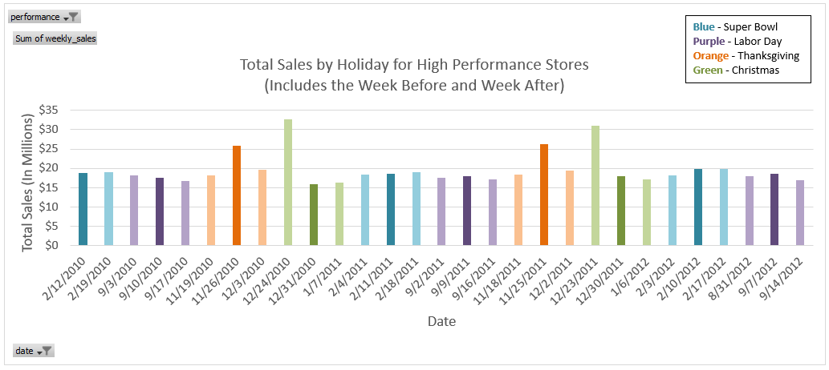
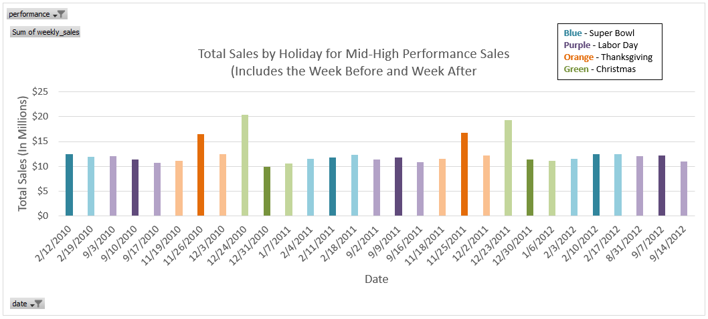
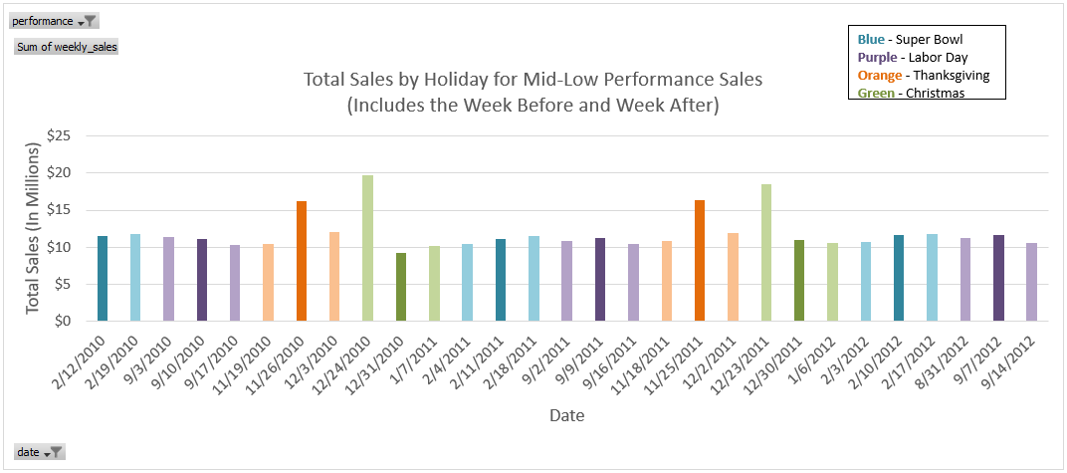
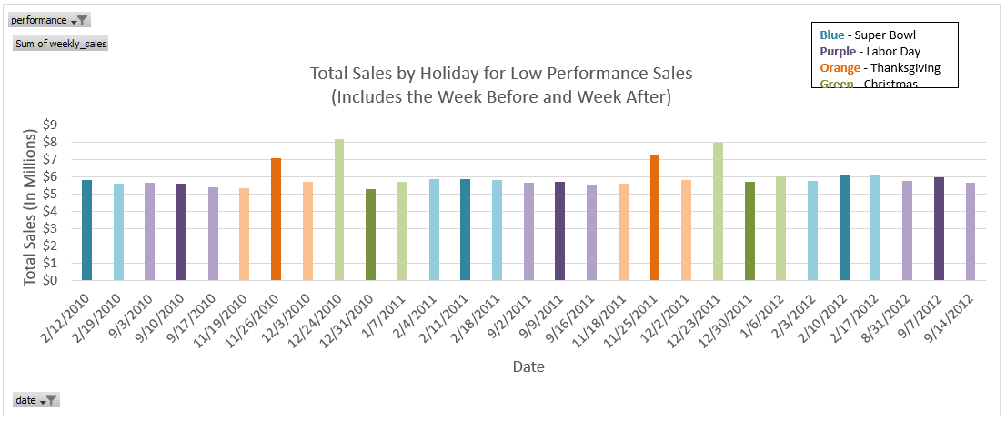
Sales Around the Holidays The data further reinforces the conclusions made from the graph with data from all stores. There are no significant differences between the different levels of performance.

Slide 24
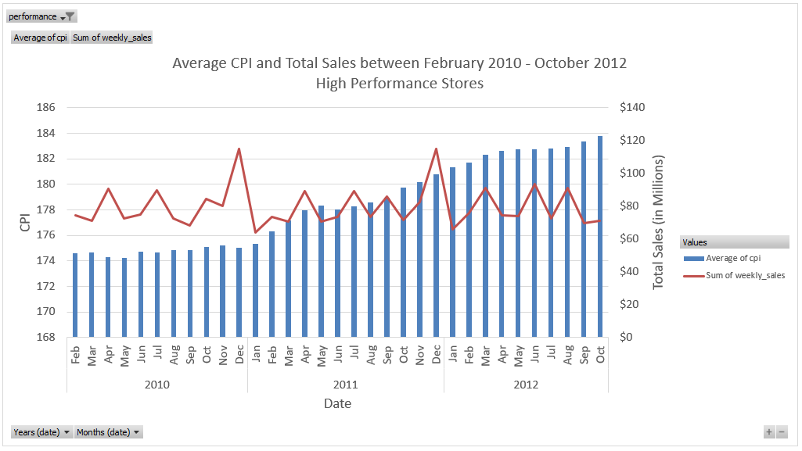
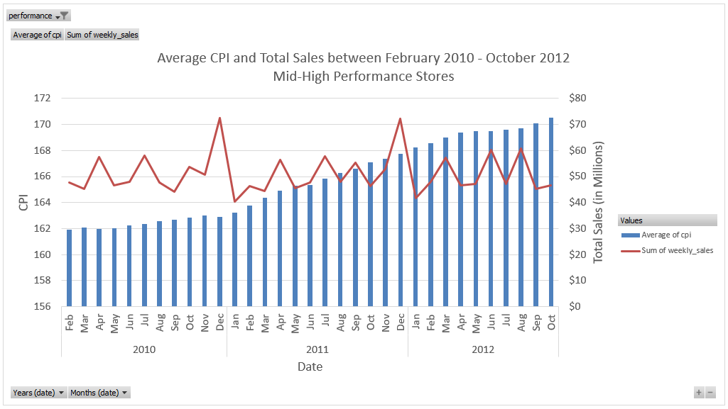
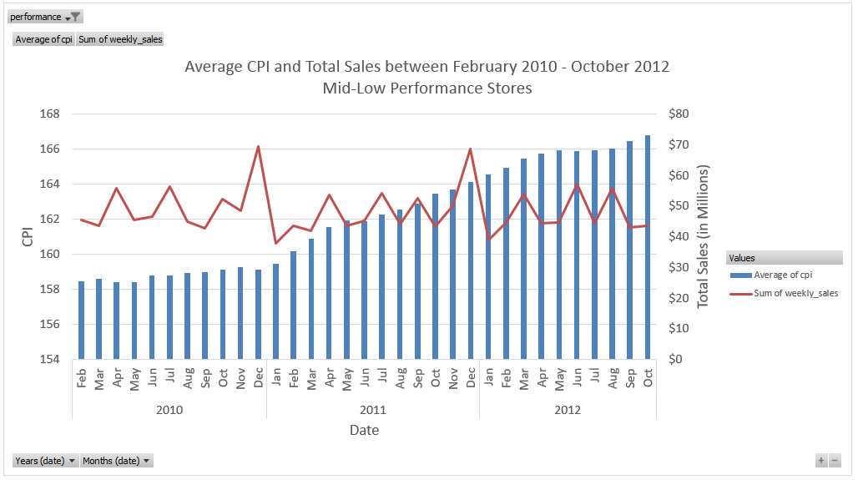
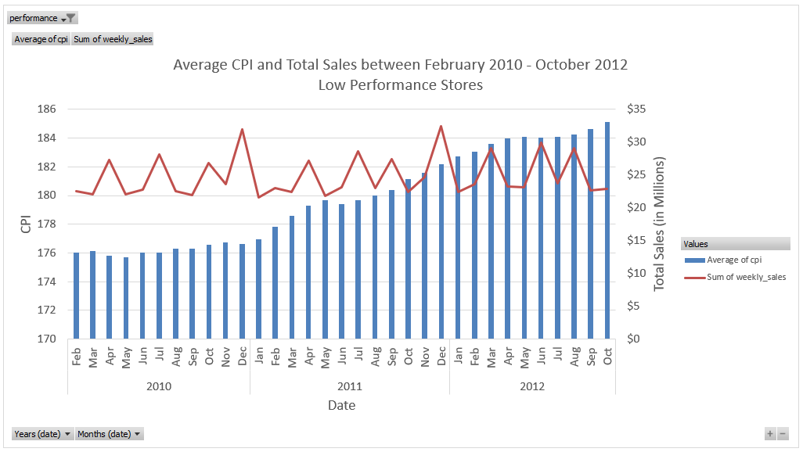
Consumer Price Index (CPI)

